Slide 1


Intro to Docker
Vincent Batts
vbatts@redhat.com
Red Hat

Slide 2







Who am I?

Slide 3
History
Dotcloud, Inc creates PaaS service
January 2013, work starts on docker internally
March 2013, first public release
Statistics:
  10,415 stars on github
  1,623 forks
  362 contributors
Massive community interest

Slide 4
Why this hype?
Solves an important problem
Easy to use
Efficient

Slide 5
Application Deployment got complex
Application Stack
Basic OS
JVM
Static web server
Front-end platform
Database layer
Application code
Deployment environments
Development VM
QA Server
Customer Data Center
Public Cloud
Contributors Laptop
Production Servers
Production Clusters
X

Slide 6
Problems
Installing software
Software versioning
Configuration
Testing

Slide 7
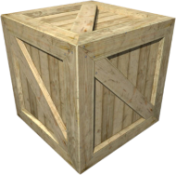
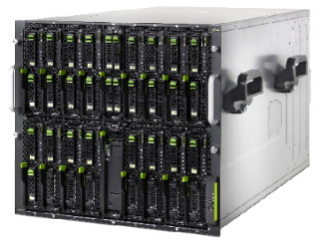


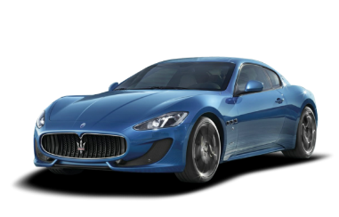
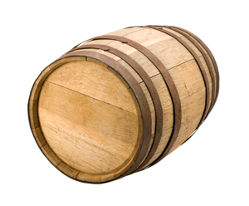
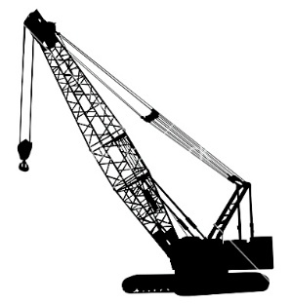


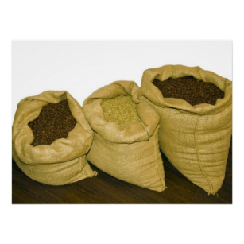
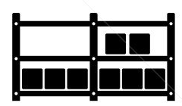
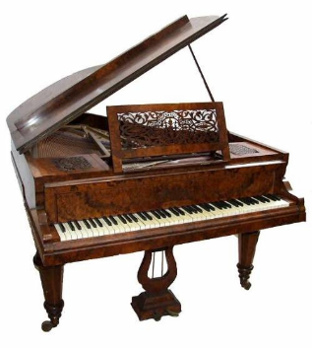


Pre-1960 shipping industry
x

Slide 8
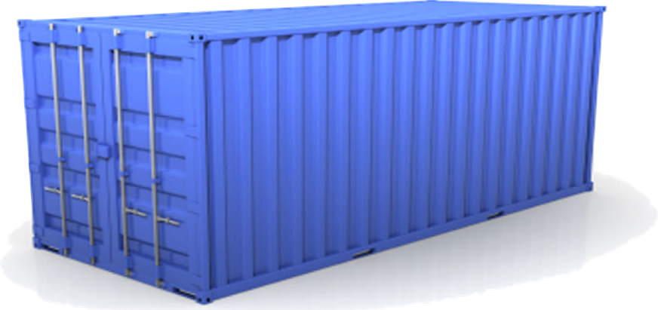
Solution: Shipping container
Separation of concerns
  User cares about packing the inside
  Shipper cares about moving the container
Standardized interface

Slide 9
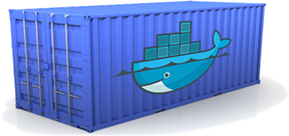
Docker containers
Standardized interface for software container
Developer concerns
Code
Libraries
Services
Configuration
Data
All servers look the same
Ops concerns
Moving containers
Starting/Stopping containers
Logging
Monitoring
Network configuration
All containers look the same
Isolation

Slide 10
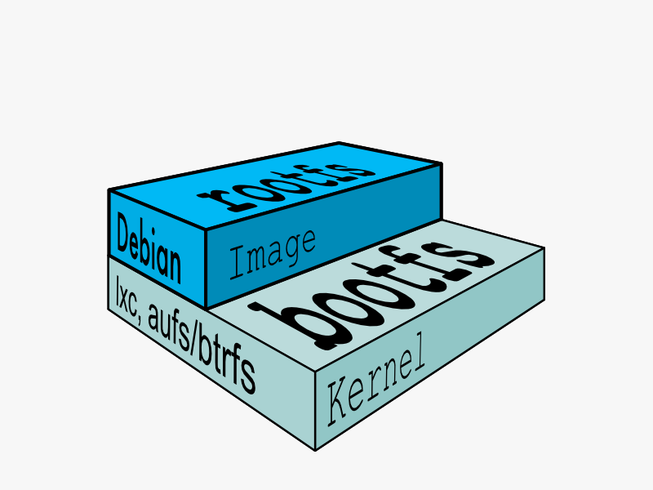
Docker glossary
Image
  Read-only template for a container
  Includes all files required for application to run
  Has additional metadata
    Exposed network ports
    Binary to start

Slide 11
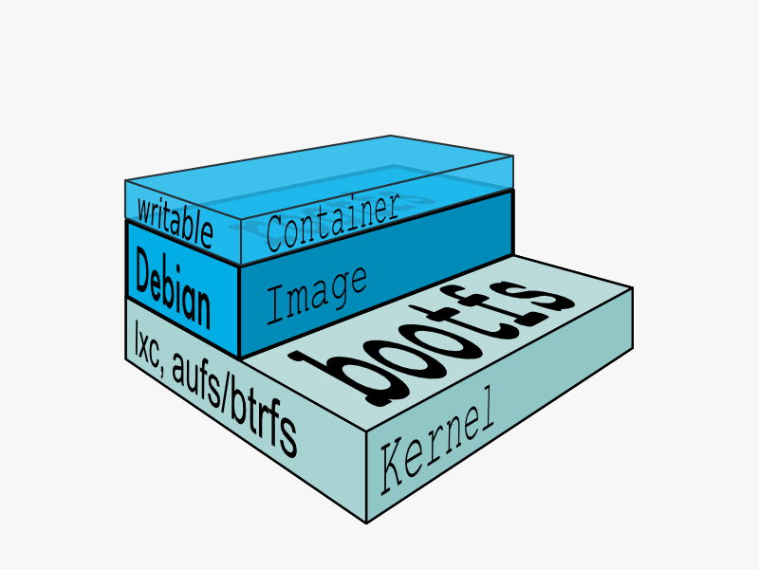
Docker glossary
Container
  Running processes
  Based on a particular image
  Typically a single process
  Isolated from host system
  Cheap
  Can write to filesystem
  Commit creates new Image

Slide 12
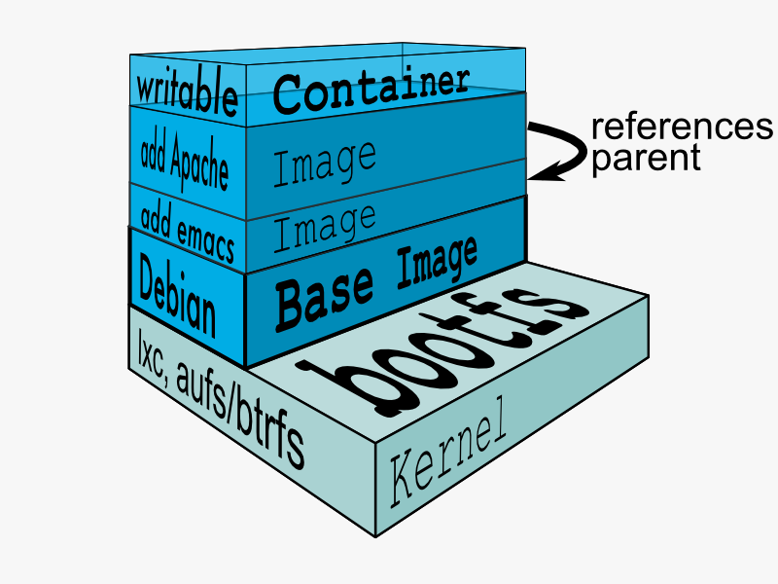
Docker glossary
Layers
  Images are based on a parent
  The layers stack on top
  Files in base layers are shared between Images
  Each commit creates a layer
  Base image has no parent

Slide 13
How does this work
cgroups
  Group trees of processes
  Allows control of resources for the group
Namespaces
  Isolate processes from host
  Network, filesystem, pids, etc
AuFS/DeviceMapper/Btrfs
  CoW snapshoting of filesystem images

Slide 14
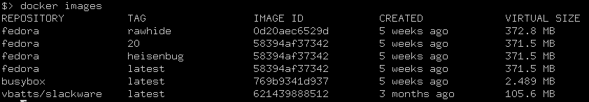
Docker 101
Hello, World!
$> docker run busybox echo “Hello, World!”
Fetch an image
$> docker pull fedora
List images
$> docker images

Slide 15
Demo!

Slide 16
Dockerfile
Simple instructions
Feels like scripting
FROM fedora
RUN yum install -y mongodb-server && mkdir -p /data/db
EXPOSE 27017
VOLUME [“/data/db”]
CMD “mongod”
Easy to make an image
$> docker build -t MY_MONGO .

Slide 17
More Topics
Working with the index (pull/push/login/search)
Using a private registry
Using volumes for data
Naming containers
Using links between containers
Creating base images

Slide 18
Questions?

